Slide 1
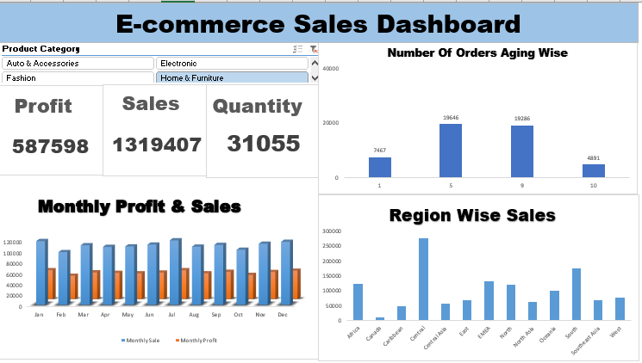
DETAILED PROJECT REPORT
On E-commerce Sales Dashboard
Created By:-
Bhavika Pathak

Slide 2
ABSTRACT
The E-commerce Sales Dashboard is designed to provide an interactive, data-driven platform to monitor, track, and analyze key performance metrics for an e-commerce business. The dashboard integrates various sales data to offer insights into revenue trends, product performance, customer segmentation, and regional sales. It is built using Excel’s advanced features such as pivot tables, formulas, and charts, with the objective of empowering decision-makers to streamline operations, identify business opportunities, and optimize sales strategies.

Slide 3
INTRODUCTION
In today's digital world, e-commerce businesses are constantly challenged with managing large volumes of data across different platforms. The ability to analyze this data effectively plays a crucial role in maintaining competitiveness and maximizing sales. The E-commerce Sales Dashboard provides a consolidated view of sales data, helping businesses understand customer behavior, product demand, and overall market trends.
The primary goal of this project is to create a user-friendly dashboard that enables businesses to make data-driven decisions to improve sales performance and operational efficiency.

Slide 4
Business Problem
The key challenge faced by e-commerce businesses is fragmented sales data from various sources, making it difficult to gain a comprehensive view of business performance. There is a need for a centralized platform that allows businesses to monitor sales KPIs, assess product trends, and evaluate customer segmentation in real-time.

Slide 5
BENEFITS
Centralized Data: Integrates data from multiple sources into one dashboard for a holistic view.
Actionable Insights: Provides visual representation of key metrics such as revenue trends, product sales, and customer behavior.
User-friendly: Non-technical users can interact with and explore data through slicers, filters, and visualizations.
Time-Saving: Automates the data updating and report generation process.
Customizable: Offers flexible reporting options tailored to different business needs.

Slide 6
PROPOSED METHOD
The development of the E-commerce Sales Dashboard involves the following key steps:
Data Pre-processing: Cleaning and organizing sales data using Excel formulas.
Feature Engineering: Extracting key metrics such as total sales, average order value, and customer segmentation.
Dashboard Design: Creating visualizations such as pivot tables, charts, and interactive elements like slicers.
Automation: Using macros to automate data updates and report generation.

Slide 7
Architecture
Data Source: Excel sheets containing sales data, product information, and customer demographics.
Data Processing: Preprocessing the collected data in Excel using pivot tables, formulas, and filtering functions.
Visualization: Creating an interactive sales performance dashboard with dynamic charts and summary tables.

Slide 8
DATASET
The dataset for this project is sourced from the e-commerce platform, which includes:
Transaction Data: Order ID, product categories, sales amount, date of sale.
Customer Information: Demographics, location, purchase history.
Product Data: Product categories, pricing, stock levels.

Slide 9
PROJECT WORKFLOW
The workflow for the project includes:
Data Collection Collecting raw sales and customer data from CSV files or databases.
Data Cleaning Cleaning the data by removing duplicates, handling missing values, and standardizing formats using Excel functions such as IFERROR, VLOOKUP, and TEXT.
Data Transformation Aggregating data and creating key metrics using Excel’s SUMIF, COUNTIF, and AVERAGE functions.
Visualization Using pivot tables and charts to create visualizations of revenue trends, product performance, and customer segmentation.
User Interface Designing an interactive UI with slicers and filters, allowing users to explore different data dimensions.

Slide 10
MODEL CREATION
The E-commerce Sales Dashboard is developed with the following components:
Data Aggregation: Using pivot tables to summarize data by category, region, and time period.
Charts and Graphs: Visualizing sales trends, product performance, and customer segments.
Interactive Elements: Slicers and filters for data exploration.
Macros: Automating the report generation and data updating process.

Slide 11
TOOLS USED
Excel: For data analysis and visualization.
Power Query: For data cleaning and transformation.
Pivot Tables and Charts: For creating summaries and visualizations.
Excel Formulas: For data manipulation and calculation.
Macros: For automation of repetitive tasks.

Slide 12
SOFTWARES
Microsoft Excel: The primary platform for data analysis and visualization.
Google Drive/OneDrive: For cloud storage and sharing.

Slide 13
DEPLOYMENT
The dashboard can be shared via cloud platforms like Google Drive or OneDrive, ensuring real-time collaboration and access across devices.

Slide 14
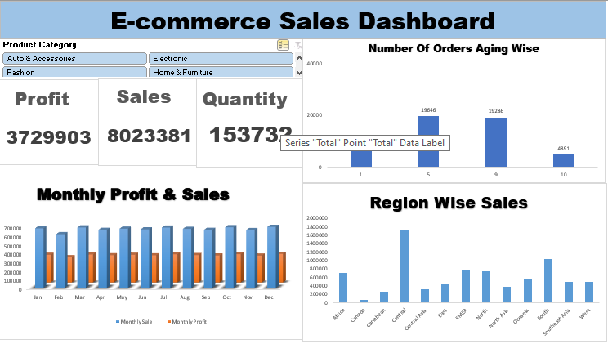
USER INTERFACE
The UI is designed with user-friendly features, including dropdown filters, slicers, and interactive charts that allow non-technical users to explore data with ease. Users can filter by product categories, date ranges, and regions.

Slide 15
PERFORMANCE EVALUATION
The performance of the dashboard is measured based on its ability to:
Handle large datasets without performance lag.
Provide real-time updates on key metrics.
Deliver accurate insights with minimal manual intervention.

Slide 16
CONCLUSION
The E-commerce Sales Dashboard provides a comprehensive and scalable solution for monitoring and analyzing e-commerce sales data. By integrating sales data and offering customizable insights, the dashboard helps businesses optimize sales strategies, improve decision-making, and enhance overall operational efficiency.

